Slide 1

Using Deep Learning to Find Stock Price Patterns
By: Chris Pranger
Regis University
Data Science Practicum II
Notes:
Welcome to a short video on my project about using Deep learning to find stock price patterns.

Slide 2
Content
Situational Context
Research Question
Data Overview
Project Methodology
Project Results and Conclusions
Disclaimer: This presentation is for academic purposes only and should not be taken as financial advice.
Notes:
In this video, I will introduce the situation, the research question, overview of the data, the project methodology, and finally, I will present the project’s results and conclusions.
As a disclaimer, everything in this video is for academic purposes only and is not financial advice.

Slide 3
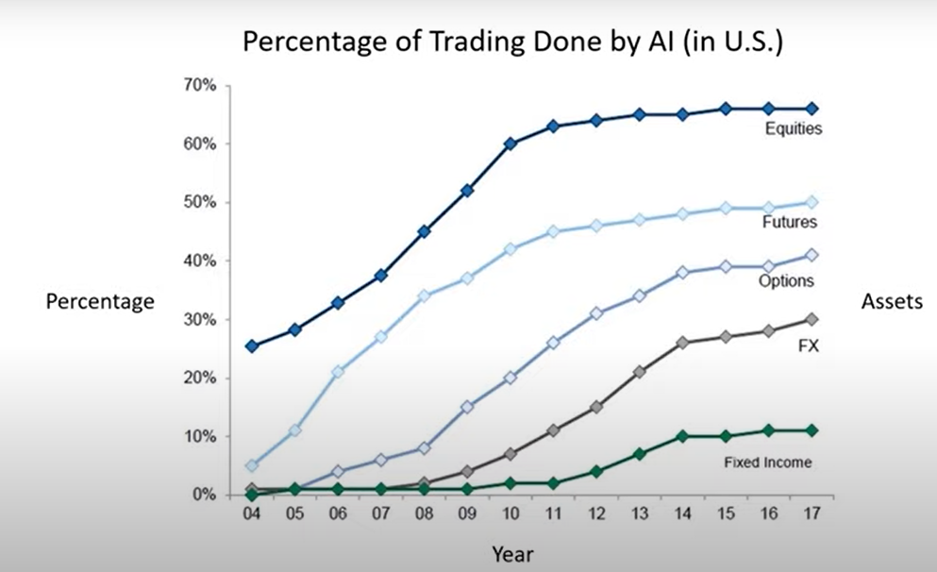
Situation
Rise of Algorithmic Trading in Recent Years
Up to 70% of all market volume
High Volume Exchange Traded Funds (ETFs)
Stocks that track an index or niche sector
Ripe for algorithmic trading
Intra-Day Trading
Lower risk exposure to pre- and post-market volatility
Recurrent Neural Networks (RNNs)
Deep Learning method for time series prediction
https://www.youtube.com/watch?v=dyZUvP5sAw8&t=60s
Notes:
Three things about today’s stock market catch my attention.
First is the rise of algorithmic trading, which accounts for 70% of the trades in the stock market.
Second, is the prevalence of Exchange Traded Funds, or ETFs. An ETF is a stock that tracks a market index or a niche sector.
Third, we’ve also seen in recent years that stock prices can be extremely volatile outside of the day’s normal market hours.
All these factors mixed with the rise of Recurrent Neural Networks, or RNNs, convalesce into an interesting research domain.

Slide 4
Research Question
Can RNNs be used on the pricing data of ETFs to find profitable trading patterns within different market time windows?
Novel Approach to a common question:
Specific Universe of ETFs
Different inter-day windows, not just predicting the next day’s price.
Binary classification instead of regression. Simply asks, will the price be higher or lower at the end of the next trading window?
Notes:
My research question is: Can RNNs be used on the pricing data of ETFs to find profitable trading patterns within different market time windows?
I believe my project is unique for a few reasons. One is my use of ETFs as the dataset. Second, is analyzing price within the day. Many studies and blogs talk about predicting stock price for the next day or days. I focus on a shorter timeline.
And finally, I structure my problem as a binary classification problem– whether the stock will go up or down. A lot of stock analysis is regression – trying to predict the exact price. I think my approach is both simpler and more useful.

Slide 5
Data
Time series stock data from Alpha Vantage
Minute-by-minute data going back 2 years for each stock
For each minute:
Open, High, Low, Close, Volume datapoints
The stocks of 54 ETFs
5 ETFs in the set will serve as proxies for economic indicators:
Economic Growth, Inflation, Unemployment, Business Confidence, and Housing
Notes:
The data I used for this project comes from Alpha Vantage, which provides minute-by-minute stock price data for the most recent two years.
Each minute is a row in the dataset and it contains the stock’s opening, closing, high, and low price for the minute, as well as how many shares were traded.
I downloaded this data for the stocks of 54 ETFs, 5 of which I also used as proxies for economic indicators that impact the stock market.

Slide 6
Project Methodology
Collect stock and economic proxies via Alpha Vantage API
Data Cleaning and Feature Engineering
Trim minutes outside of market hours and impute missing values
Feature engineer technical indicators (RSI, Bollinger Bands, Moving Average)
Feature engineer time features (Hour, Minute, Day of Week)
Exploratory Data Analysis
Plot prices
Calculate % of Missing Values
Class Balance
Notes:
The first step in the project was to download the data.
Next, I cleaned the data and engineered features.
The first features I engineered were technical indicators that are commonly used in quantitative investing. They include RSI, Bollinger Bands, and Moving Average.
I also engineered features for the hour, minute, and day of the week.
The next step in the project was exploratory data analysis. I plotted the stock’s prices, calculated missing value percentages, and checked class balance.

Slide 7
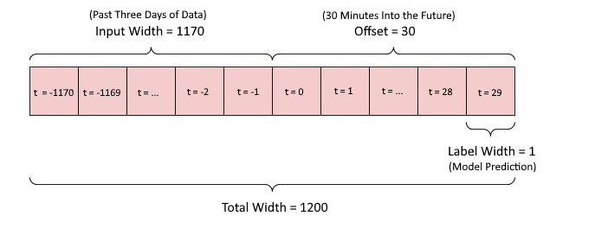
Project Methodology (cont.)
Data Preparation
Stationarity
Feature Scaling
Data Generator
Determine Model Architecture
Stacked LSTM Layers
Parameter Testing
Training The models
Train, validate, evaluate, and save models
Notes:
After I had clean data with features, I was able to prepare it for machine learning. For this, I needed to transform my data to be stationary and then scale the features.
My datasets were large, so I had to create a Data Generator which windows the data in real time as it feeds it into the model. The graphic demonstrates how 3 days of data is fed to the model and then the model makes a prediction for 30 minutes into the future.
After having this structure set up, I was able to start building the models. I used two stacked LSTM layers and tested different parameters such as layer size, dropout and recurrent dropout values.
After settling on the final model architecture, I trained, validated, evaluated, and saved the models.

Slide 8
Results
Model Performance Overall:
18 of 54 Models had an ROC score greater than 50%
Model Performance by Trading Window:
Some models have much higher ROC Scores for specific windows
For Example: The ETF “TQQQ” has an ROC score of 90% for the 30-minute window starting on Tuesday at 1:30 PM.
Plotly Dash Application – Slice and Dice the data table to find profitable patterns.
http://chpr1410.pythonanywhere.com/
Example Strategy: Investing in each window with an ROC >80%
Average weekly return of 4.63% - or 954% annually.
Notes:
Over the dataset as a whole, 18 of the 54 models achieved an ROC score greater than 50%, which is a good threshold to use for the stock market.
I also evaluated each model on every one of the 35 different 30-minute trading windows of the week.
Evaluating the models on individual trading windows showed that some models perform very well in a more granular view.
For example, the ETF with symbol TQQQ achieved an ROC score of 90% for the window at 1:30 on Tuesdays.
I also created a Dash application to visualize the results. Interacting with it shows different windows and their ROC scores and investment returns.
One example strategy includes investing in each stock and window pair that achieved an ROC Score over 80%. This strategy had an average weekly return of 4.63%. The passive return for this same strategy is just -0.06% per week.
Interacting with the dashboard shows several other profitable strategies

Slide 9
Conclusions
Answer to My Research Question:
Yes, deep learning can seemingly find stock pricing patterns for different windows.
It can be hard to find patterns for ETF data overall, but patterns for certain ETFs during certain windows of the day are much more evident
2 Caveats
Patterns in historical data do not guarantee the same patterns in future data
Sample Size:
Entire Dataset was 2 years. The 10% test dataset that the models were evaluated on represents 10 weeks
Data Science Strategies Can Work
See: Renaissance Technologies (66% annual returns – before fees – since 1988)
But Traders Must Always Tread Carefully.
See: Lots of bankrupt quantitative investors
Notes:
In conclusion, this project showed that deep learning can be used to find price patterns for ETF stocks.
It can be hard to find patterns in the data overall, but patterns for certain windows of the trading week are much more evident to the models.
Of course, the results come with two big caveats: One is that past results do not indicate future performance. And second, only having 2 years of data is pretty limited.
Overall, this project showed me that deep learning can discover potentially profitable trading strategies, BUT traders must always tread carefully. For every successful quantitative investor, I would bet that there are several ones that failed.

Slide 10

Contact
Chris Pranger
Regis University
Master of Data Science Program
Email: cpranger@regis.edu
GitHub: https://github.com/chpr1410/MSDS696-Practicum
LinkedIn: https://www.linkedin.com/in/christopherpranger/
Notes:
Please feel free to reach out to me with any questions or comments. Thanks for watching.

